Slide 1

COVID-19
PROJECT USING CHATBOT
Name | Registration Number | Roll Number
Anay Sarkar | 17013000384 | 17010301017
Sourit Paul | 17013000539 | 17010301171
Sanchary Chanda | 17013000501 | 17010301134
Rai Banik | 17013000476 | 17010301109
Rupak Dey | 17013000494 | 17010301127
Under the Supervision of Milan Pradhan

Slide 2
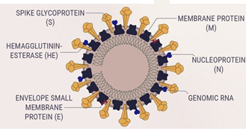
ABOUT COVID-19
Coronavirus: a type of virus that infects humans, typically leading to an Upper Respiratory Infection (URI.) Seven different types of human coronavirus have been identified till date & this is the deadliest.
It spreads mainly through person-to-person contact.
Infections range from mild to deadly.
COVID-19

Slide 3
WHY WE DECIDED TO BUILT THIS PROJECT?
As COVID-19 is creating serious threat to human life’s so we as a human should have to take the responsibility to make others aware about the virus so that they can take fruitful steps against it.
One of the main motives is to reduce the wastage of covid-19 test kits and the other motive is to make others, knowledgeable about the virus so that everyone could take precautions from it.

Slide 4
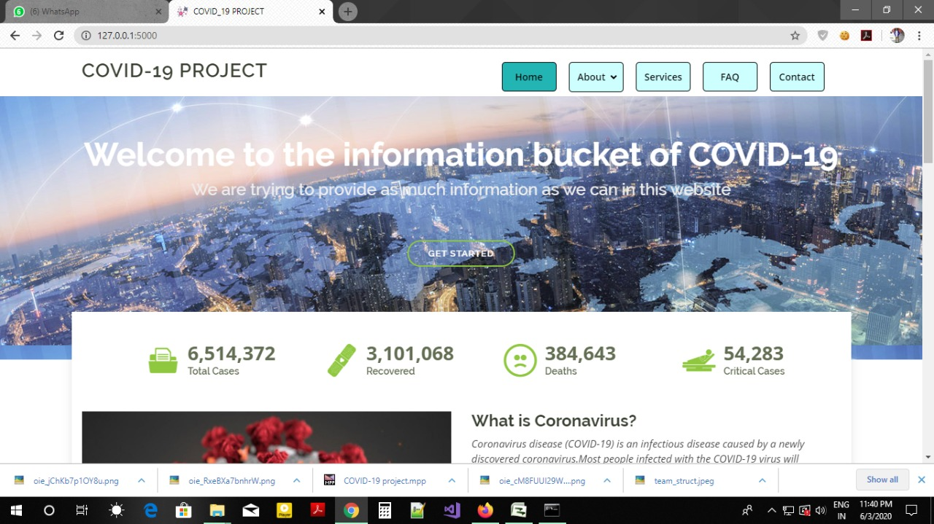
ABOUT THIS WEBSITE?
A brief description about this pandemic.
A real-time API(application program interface) for tracking total cases, recovered, deaths, critical cases patients across the world.

Slide 5
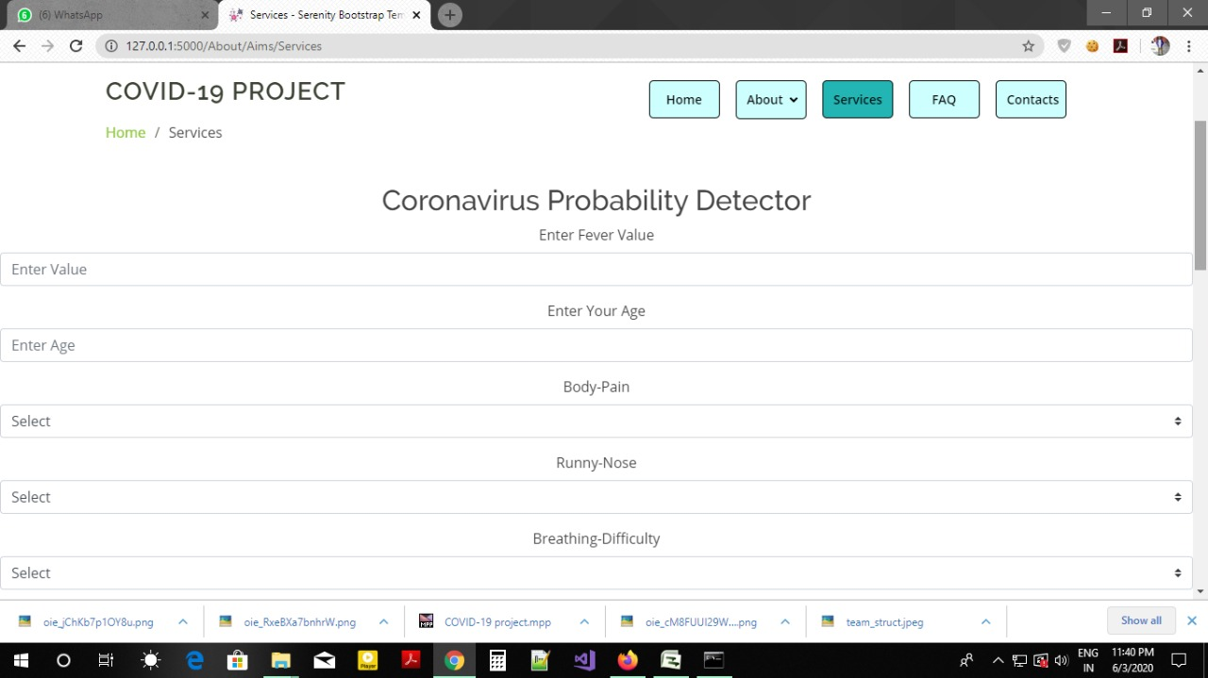
COVID-19 PROBABILITY DETECTOR?
The client will give their details of their symptoms and the website will predict whether they are affected with COVID or not in the form of percentage.
If the percentage exceeds 75 percent or more then they should consult the doctor otherwise not needed.

Slide 6
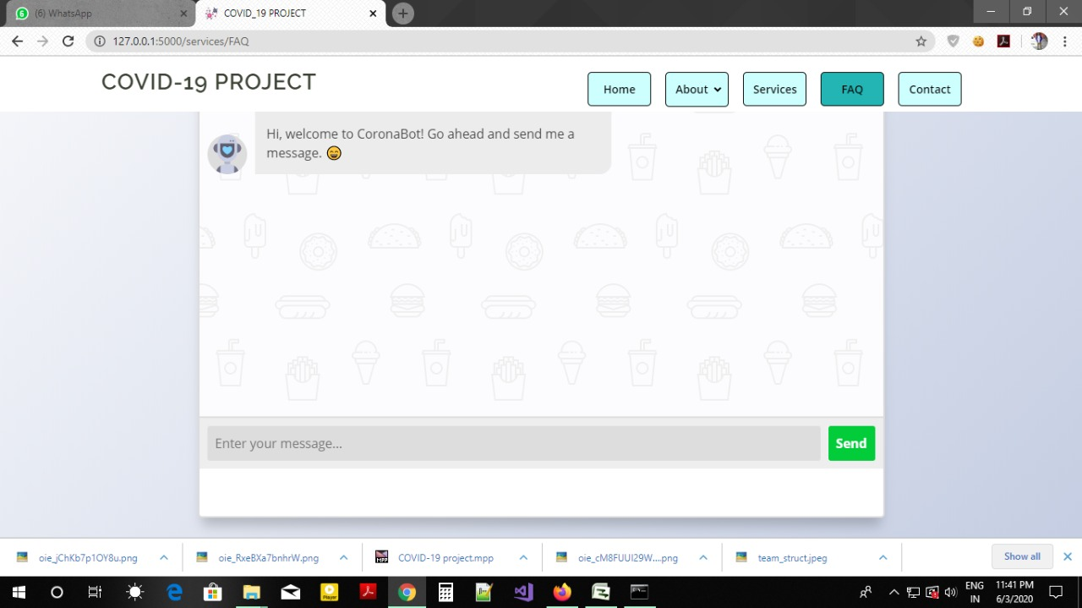
CHATBOT IN OUR WEBSITE?
In order to solve this issue a chatbot has been implemented, to convey correct and accurate symptoms, remedies(if any).
It also provides a virtual one on one communication platform which makes the user or client a bit comfortable and confident to share his or her opinion.

Slide 7
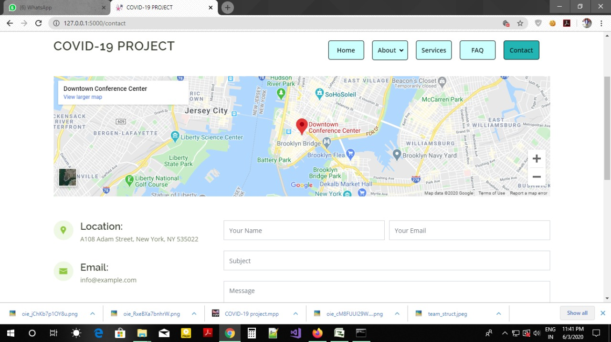
CONTACT
We have added an embedded google map display of our office so it can help the clients.
The form that we have designed to listen to our client queries contains a validator.

Slide 8
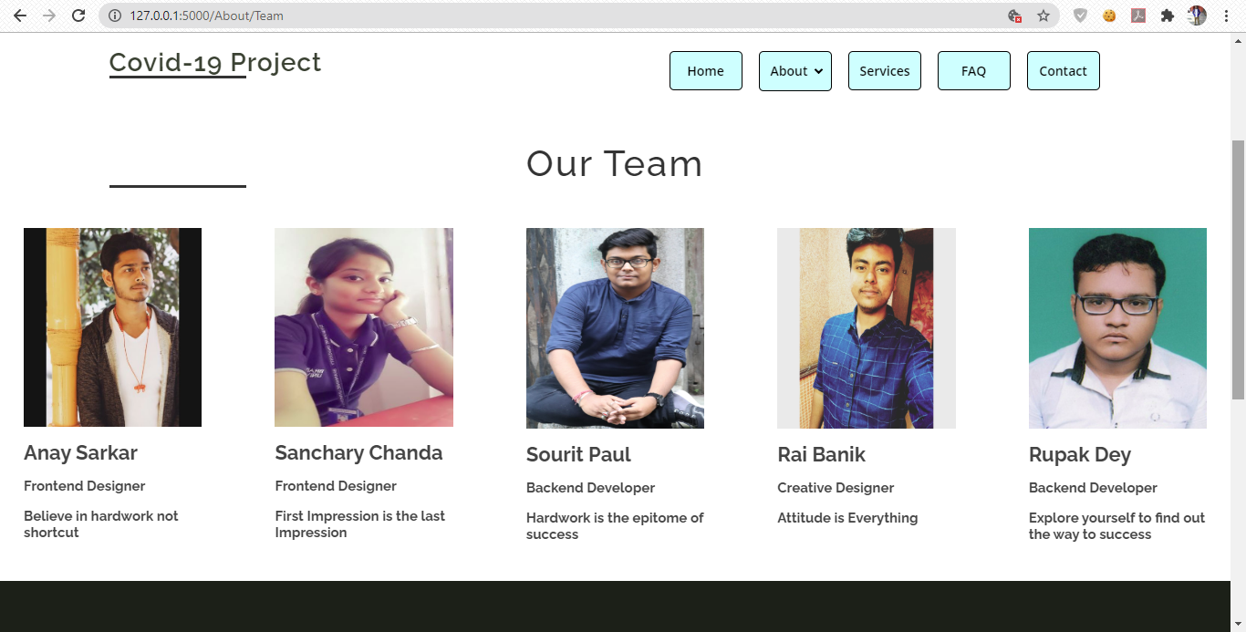
ABOUT US

Slide 9
CONCLUSION
It is in a prototype state so if we can get good resources in the future, then this project can be efficient for doctors. Considering the trending technologies like python and machine learning we have tried to execute on this.
Through this project, I want to request each and every people to help the other in their most possible ways because together we can succeed and one day we will definitely overcome this pandemic and world will be again an amazing place to live on.

